Slide 1

Using news to predict Stock movements
Presented by : Anupriya Thirumurthy, Madhavi Polisetti, Desen Liu
Notes:
Anu, Desen and Madhavi worked on this case study () and it’s also an active Kaggle competition.

Slide 2

Problem Statement
Dataset
Data Exploration
AGENDA
New Features
ML Classifier Comparison
Overfit/Underfit
Results
Selection Criteria
Conclusion(s)
Future Work

Slide 3
Problem Statement
Stakeholders
Can we use News to predict Stock price movement ?
?
Research Groups
Investment Companies
Notes:
We explored the problem statement “”
Research groups interested in understanding the predictive power of the news.
Investment companies : interested in this case to make better investment decisions

Slide 4
Dataset – Part 1
Time Series market data - 4072956 rows of 16 features
Asset info
Asset code
Asset name
Returns info
Returns-Variables:
Open/close
Raw/Market-Res
Prev/Next
Target - Next 10-day Stock Returns
Trading info
Trading DateTime
Trading volume
Opening price
Closing price
Notes:
We have two part dataset.
Part-1 was 10 years worth of daily time series data with about 5 million rows and 16 features.
Some of the features could be grouped into Asset/ Trading/Returns information.
Asset information is company specific info like Stock Code, Company name etc.
Trading info is daily stock volumes, prices.
Returns info was meant to indicate stock performance relative to the market.
Target variable: Next 10 day returns

Slide 5
Dataset – Part 2
Time Series news data - 9328750 rows of 35 features
Article info
Headline text/Headline Tag
Urgency
News Provider
Sentence Count
Time Variable(s) -firstcreated
News Quality
7 day Novelty Counts
7 day Volume Counts
Sentiment info
Sentiment Class
Sentiment Negative
Sentiment Positive Sentiment word Count
Notes:
Second part was daily time series news data with 35 features.
We grouped them into 3 buckets: Article info - Urgency, relevance, count and who was the provider

Slide 6
Key Information
Time Indicators
Timestamp(s)
First Created
Sentiment data
Sentiment class wordcount
Stock Returns
Data
Returns
Target Prediction
T
A
B
C
6
Notes:
Raw Returns variables → 1) Stock returns averaged over a period of time 2) Not adjusted against any benchmark.
Market-residualized variables → 1) Stock returns averaged over a period of time 2) Adjusted against any benchmark.
Sentiment data → probability that the sentiment of the news item was negative, positive or neutral, Sentiment word count.
Target → Confidence level of stock movement.

Slide 7
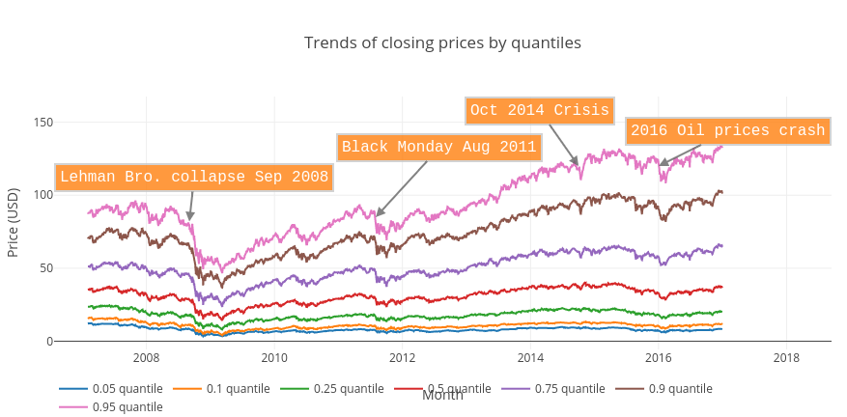
Data Exploration
Notes:
Exploring Close prices, we found some important trends. These dips in prices imply coincide with infamous market crashes.
Based on this, we excluded certain time periods in our training data. -- Especially data before 2009 wasn’t reflective of current market.
This is not useful for predicting future trends as Market crash of 2008 was a Black Swan event.
Sep 2008 - Infamous Market Crash - it was the largest point drop in history - It plummeted because Congress rejected the bank bailout bill.
Aug 2011 - Black Monday - S&P downgraded U.S credit rating.
Oct 2014 - Stocks fell over the fear of mounting global crises, including the first domestic case of Ebola, as well as the looming possibility of an interest rate hike.
2016 - Stockmarket crash due to Oil prices crash

Slide 8
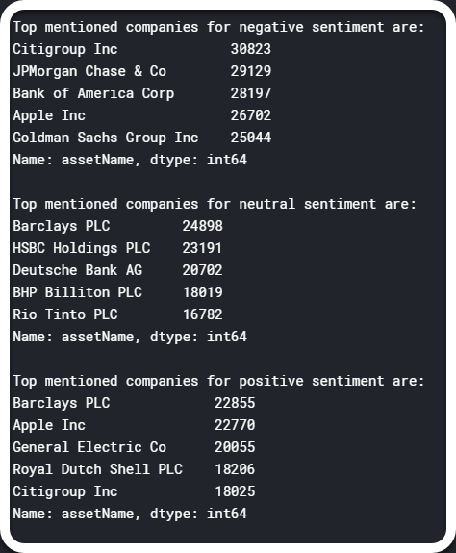
Assumptions
Data Exploration
Data Reduction
Subset of data:
Years 2014 - 2017
Top 100 companies with news data
Rephrase Problem
Predict next 10 day stock movement ( Up or Down)
Data Labeling
Next 10 Days Stock Returns
variable to label rows as stock movement ( Up or Down).
Notes:
Here are some assumptions we made.
We chose 2014-2017 as it is more recent and reflective of current trends.
There were about 4000 companies. Not all had news data. Since we are evaluating predictive power of news, we chose top 100 companies with news.
Our original prediction involved confidence level for stock movement. For the sake of ML project , we chose to fit models for Stock Up/Down.

Slide 9
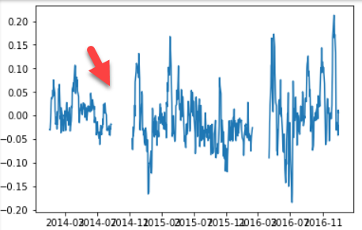
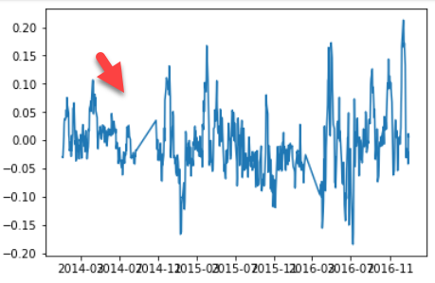
Data Exploration
Feature Engineering
Stock Returns
Missing Data
Time series interpolation
Spot Outliers and treat them
New Features
Account for time series autocorrelation
Past Stock performance
Temporal information.
Stock Returns
Notes:
We used time series interpolation techniques to correct missing data.
Took a look at Outliers that might affect our results.
We decided to fit Machine Learning models against Time Series ones as ML ones are more relevant to this class.
This meant that our models needed to be fed features that captures autocorrelation between observations. We played with a whole slew of new features.

Slide 10
New Features
Day of the Year
Week Number
Month
Quarter
Holiday
01
Temporal Features
02
Trading Features
(RSI) - market strength
Bollinger Band - volatility
MACD - momentum
03
Recent Data
Numeric asset (stock) Code
Prev 20 day stock returns
Prev month’s returns
Prev quarter’s returns
04
Rolling Data
Rolling Mean(s) - Price, Volume
Rolling Sum - News variables (urgency, relevance)
10
Notes:
The ones highlighted in red were the most relevant features based on the Feature importance plot
Trading Features - We used some technical indicators that traders used in financial market analysis.
Relative Strength Index : Chart the current and historical strength or weakness of a stock
Bollinger Band: Bollinger Bands are volatility indicator
MACD: The Moving Average Convergence Divergence (MACD) is a momentum indicator that shows the relationship between two moving averages of a stock’s price

Slide 11
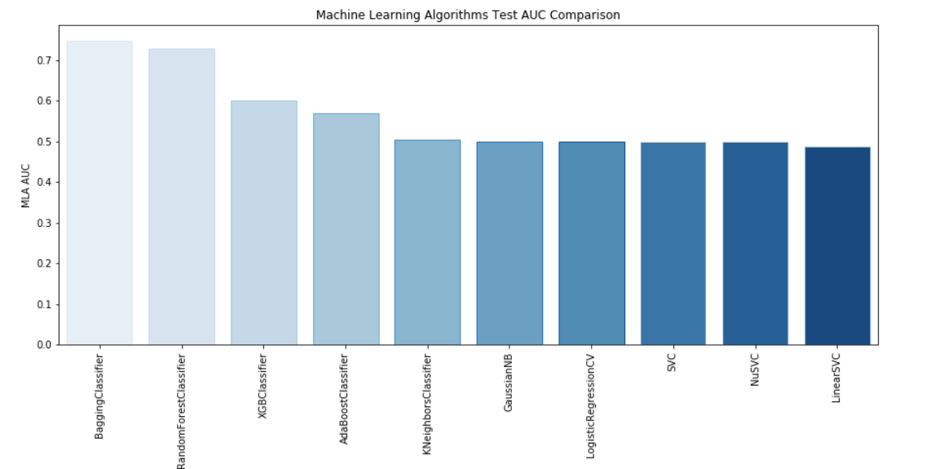
Comparing ML Classifier(s) – AUC Scores

Slide 12
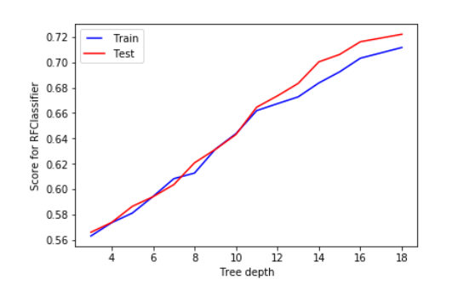
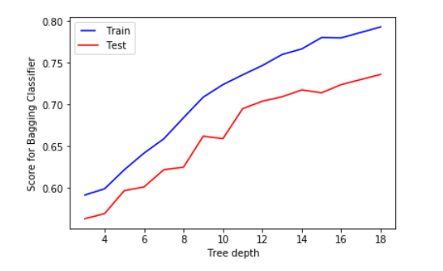
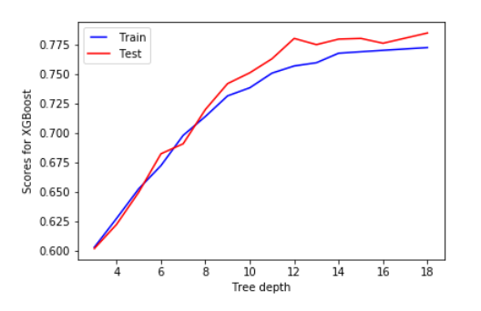
Overfit – Underfit Curves for Top 3 Classifiers
Random Forest
Bagging Classifier
XGBoost
Notes:
https://github.com/dmlc/xgboost

Slide 13
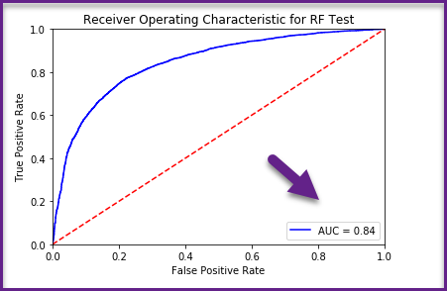
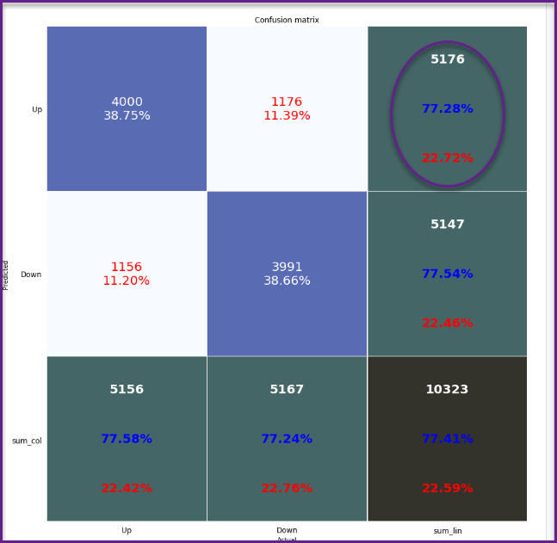
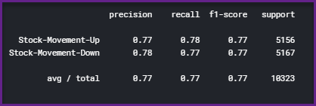
Classifier #2 – Random Forest Classifier

Slide 14
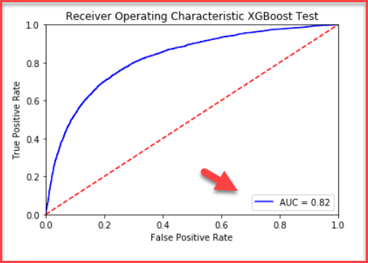
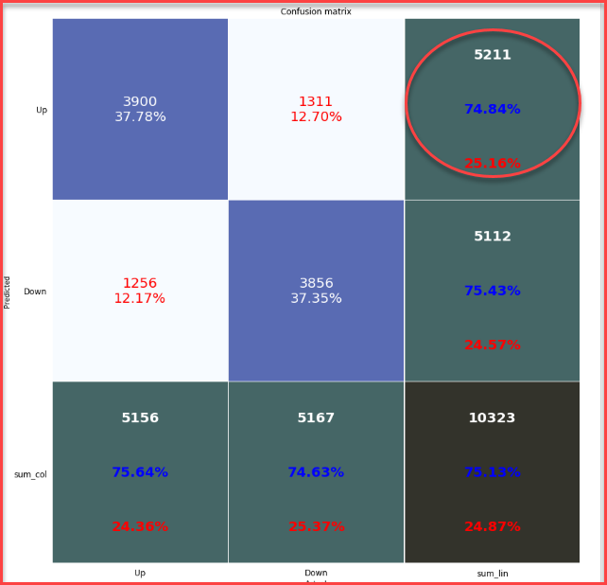
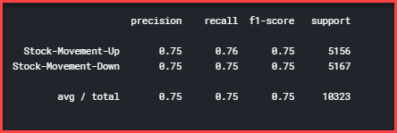
Classifier #3 – XGBoost Classifier

Slide 15
Selection Criteria – F1 Score
Maximize True Positive
Reduce False Negative to avoid missing gain (Recall)
Reduce False Positive to avoid excessive loss (Precision)
Predicted Class
True Positive
(TP)
False Negative
(FN)
True Class
False Positive
(FP)
True Negative
(TN)
F1 assumes that fp and fn are equally bad
Based on user/financial institution risk level, F1 score can be modified
Notes:
https://en.wikipedia.org/wiki/Precision_and_recall

Slide 16
XGBoost Results – Revisit
Predicted Class
True Positive
(TP)
False Negative
(FN)
True Class
False Positive
(FP)
True Negative
(TN)

Slide 17
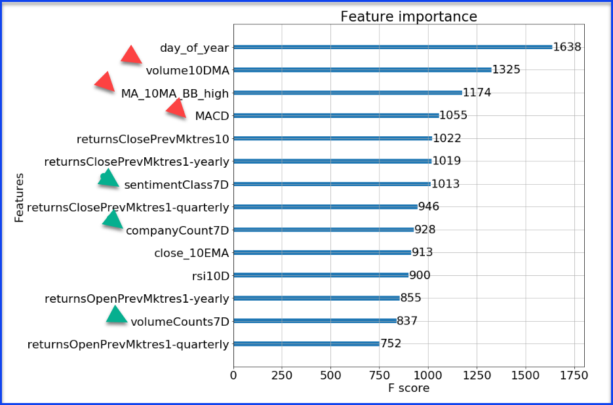
XGBoost Feature Importance Plot

Slide 18
Conclusions
01
AUC and F1 score suggests a working and robust model
02
Company’s past performance is a strong predictor
03
Cumulative news data affect the stock movement
04
Market data is more powerful than news data
18

Slide 19
Future Work
01
Time Series / Recursive Neural Net
02
Expand the scope of news data, e.g. breaking news, regulation news
03
Obtain the news data drilled down to hourly time series
04
Try models with market data only
05
Predict confidence levels for Kaggle competition
19

Slide 20
THANK YOU

